Slide 1
Introduction

Slide 2


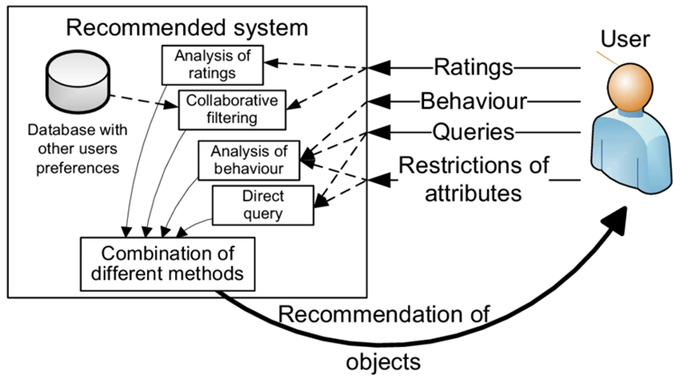

Slide 3
Recommender
System
User preferences
Recommendation
Recommender systems
Utilize various sources of data to infer customer interests
Recommendation analysis is often based on the previous interaction between users and items

Slide 4

Goals of Recommender Systems
Increasing product sales is the primary goal of a recommender system
The common operational and technical goals of recommender systems are
Relevance
The most obvious operational goal
Novelty
The recommended item is something that the user has not seen in the past

Slide 5
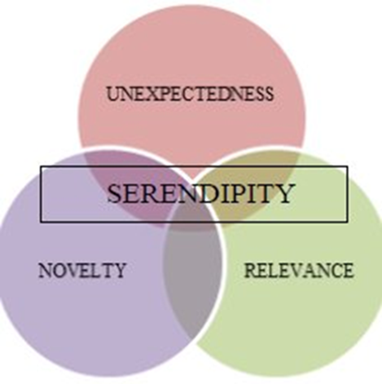
Serendipity
The items recommended are somewhat unexpected
Has the beneficial side effect of increasing sales diversity or beginning a new trend of interest in the user
Increasing recommendation diversity
When the recommended list contains items of different types, there is a greater chance that the user might like at least one of these items.

Slide 6
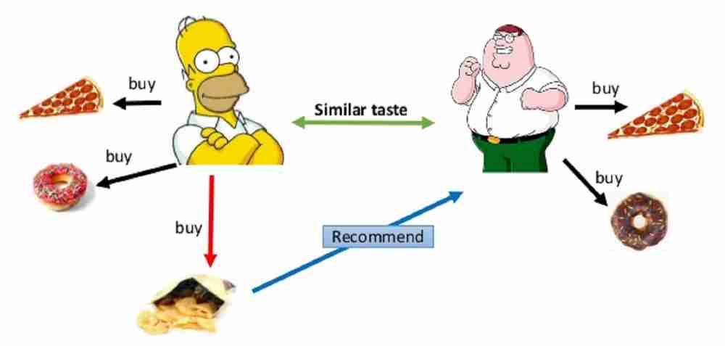
Basic models of Recommender System
Collaborative Filtering Models
Memory-based methods
User-based CF
Item-based CF
Model-based methods
We need users ratings

Slide 7
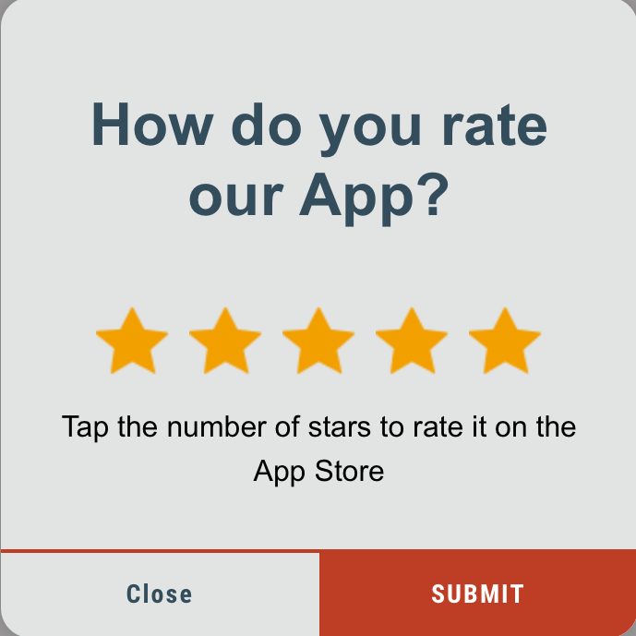
Basic models of Recommender System
Types of ratings
Explicit rating
Implicit ratings
User’s action
Click, Buying an item, etc.

Slide 8
More on ratings – Explicit ratings
Probably the most precise ratings
Most commonly used (1 to 5, 1 to 7 Likert response scales)
Research topics
Optimal granularity of scale; indication that 10-point scale is better accepted in movie dom.
Main problems
Users not always willing to rate many items
number of available ratings could be too small → sparse rating matrices → poor recommendation quality
How to stimulate users to rate more items?

Slide 9
More on ratings – Implicit ratings
Typically collected by the web shop or application in which the recommender system is embedded
When a customer buys an item, for instance, many recommender systems interpret this behavior as a positive rating
Clicks, page views, time spent on some page …
Implicit ratings can be collected constantly and do not require additional efforts from the side of the user
Main problem
One cannot be sure whether the user behavior is correctly interpreted
For example, a user might not like all the books he or she has bought; the user also might have bought a book for someone else

Slide 10
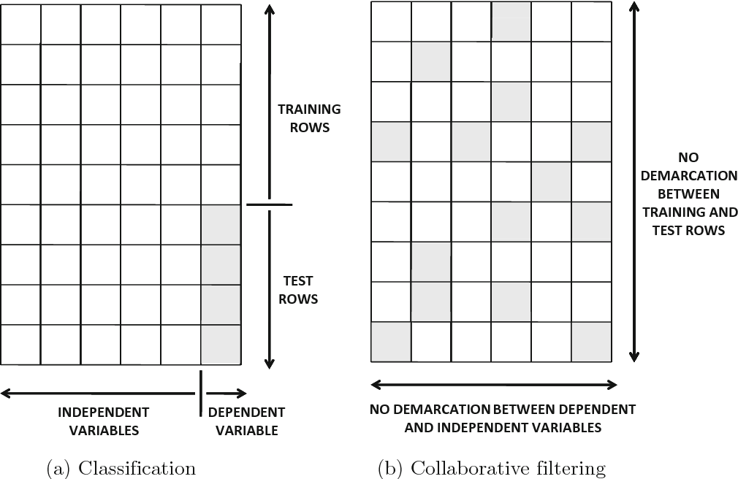
Collaborative Filtering as a Generalization of Classification and Regression Modeling
Collaborative filtering methods can be viewed as generalizations of classification and regression
modeling.

Slide 11
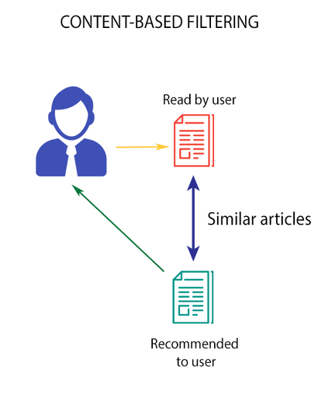
Basic models of Recommender System
Content-based recommender system
The descriptive attributes of items are used to make recommendations
Adv
Making recommendations for new items when sufficient rating data are not available for that item.
Disadv
May provide obvious recommendations because of the use of keywords or content
They are not effective at providing recommendations for new users.

Slide 12
Basic models of Recommender System
Knowledge-based recommender systems
Particularly useful in the context of items that are not purchased very often.
Automobiles, tourism requests, expensive luxury goods…
The recommendation process is performed on the basis of similarities between customer requirements and item descriptions, or the use of constraints specifying user requirements.

Slide 13
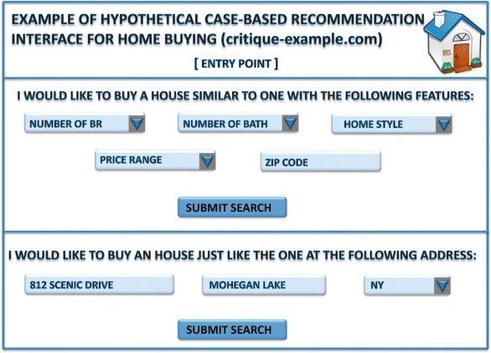
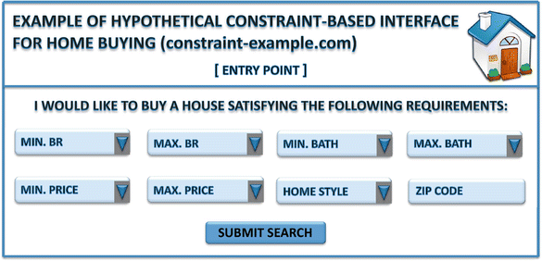
Basic models of Recommender System

Slide 14
Domain-specific Challenges
Time-sensitive recommender systems
The rating of an item might evolve with time
The rating of an item might be dependent on the specific time of day, day of week…
Location-based recommender systems
Social recommender systems
Structural recommendation of nodes and links
Product and content recommendations with social influence

